Slide 1

Wine Quality
By :- Siddhikesh Gavit

Slide 2
Overview…
Dataset: Red Wine Quality Dataset (1599 samples, 12 attributes)
Goal: Analyze factors influencing wine quality & predict wine quality
Quality Scale: 0 (worst) to 10 (best)
Attributes:-
Fixed Acidity
Volatile Acidity
Citric Acid
Residual Sugar
Chlorides
Free Sulfur Dioxide
Total Sulfur Dioxide
Density
pH
Sulphates
Alcohol
Quality

Slide 3
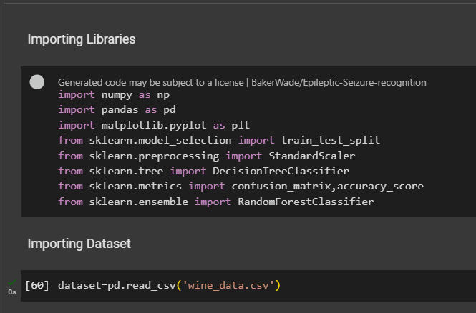
Libraries Used…

Slide 4
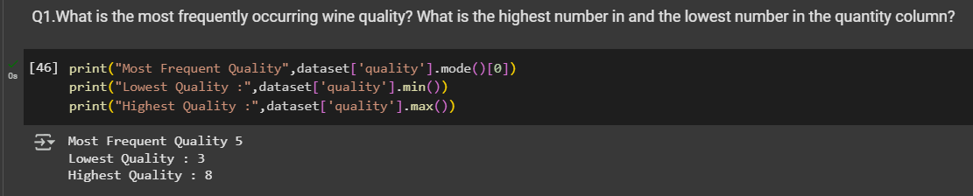
Q1.What is the most frequently occurring wine quality? What is the highest number in and the lowest number in the quantity column?
Most frequent wine quality: 5
Lowest quality: 3
Highest quality: 8

Slide 5
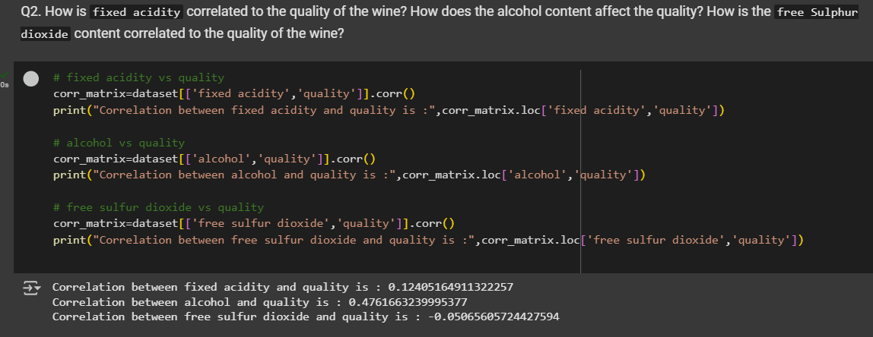
Q2. How is `fixed acidity` correlated to the quality of the wine? How does the alcohol content affect the quality? How is the `free Sulphur dioxide` content correlated to the quality of the wine?
Fixed Acidity vs. Quality: Weak positive correlation (0.124) → Minor impact
Alcohol vs. Quality: Moderate positive correlation (0.476) → Higher alcohol improves quality
Free Sulfur Dioxide vs. Quality: Very weak negative correlation (-0.051) → No significant impact

Slide 6
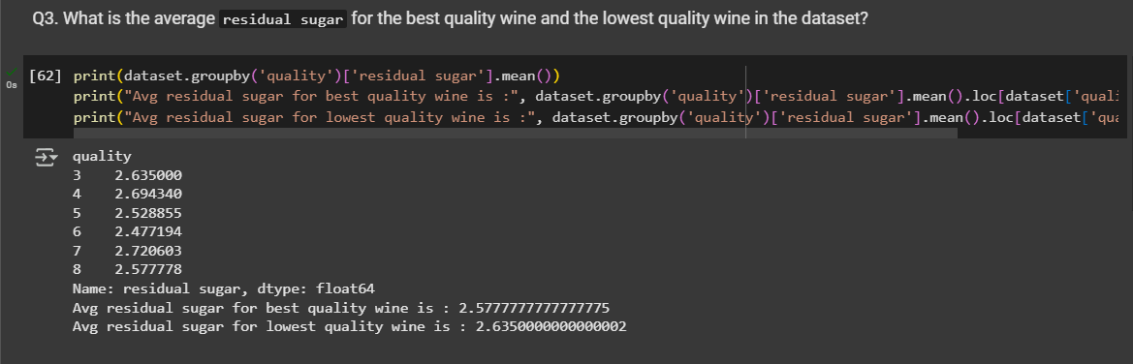
Q3.What is the average `residual sugar` for the best quality wine and the lowest quality wine in the dataset?
Best Quality Wine (8): Avg. residual sugar 2.58 g/L
Worst Quality Wine (3): Avg. residual sugar 2.64 g/L
Insight: Residual sugar does not significantly impact wine quality

Slide 7
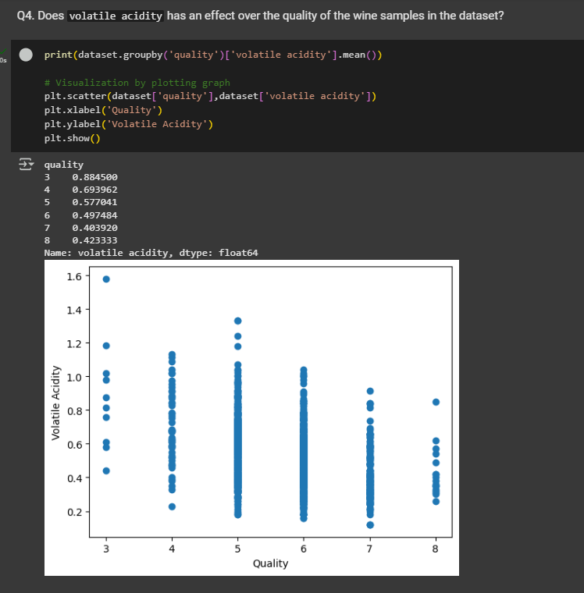
Q4. Does `volatile acidity` has an effect over the quality of the wine samples in the dataset?
Moderate negative correlation: -0.391
Higher volatile acidity → Lower quality
Quality 3 Wines: Highest volatile acidity (0.884 g/L)
Quality 8 Wines: Lowest volatile acidity (0.423 g/L)
Insight: Lower volatile acidity results in better wine quality

Slide 8
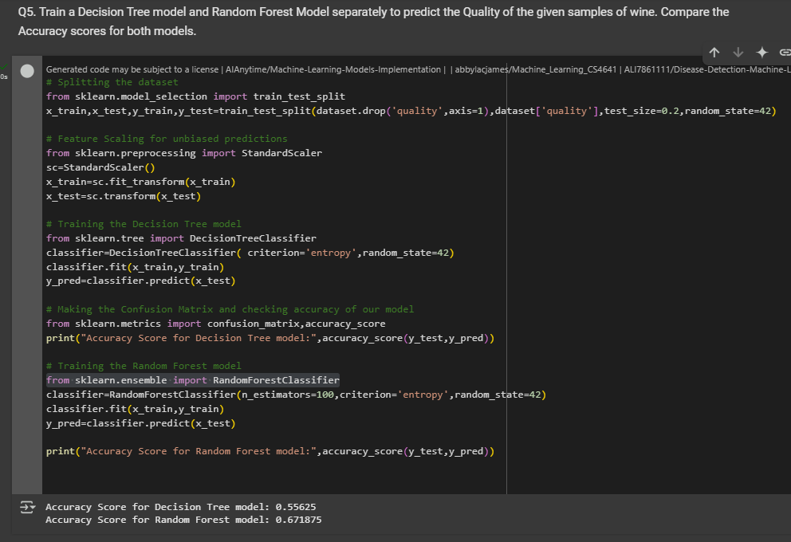
Q5. Train a Decision Tree model and Random Forest Model separately to predict the Quality of the given samples of wine. Compare the Accuracy scores for both models.
Accuracy:-
Decision Tree → 55.6%
Random Forest → 67.1%
Random Forest performs better as it reduces overfitting and generalizes better

Slide 9
THANK YOU…
@Finlatics

